Slide 1
NAME: Kalluri Venkata jhansi ORGANIZATION: Micro IT TOPIC: PORTFOLIO
PORTFOLIO

Slide 2

INTRODUCTION
A portfolio is a collection of financial investments like stocks, bonds, mutual funds and cash.
This project focuses on understanding how investment portfolios are created, managed, and optimized to meet specific financial goals.

Slide 3
OBJECTIVES OF THE PROJECT
To understand the concept of portfolio management.
To study different types of investment portfolios.
To learn the risk-return trade-off.
To apply theoretical knowledge in real-world portfolio design.

Slide 4
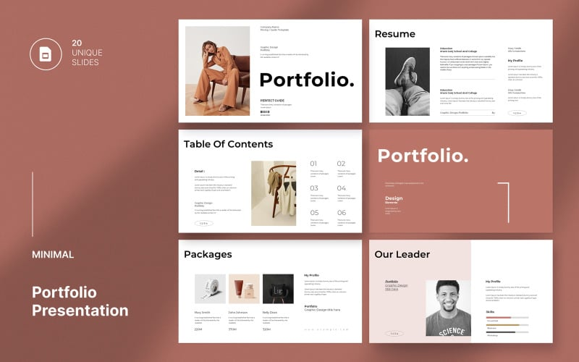
WHAT IS PORTFOLIO?
A portfolio refers to a collection of financial assets held by an investor.
Types of portfolios:
Aggressive portfolio
Conservative portfolio
Balanced portfolio
Income portfolio

Slide 5
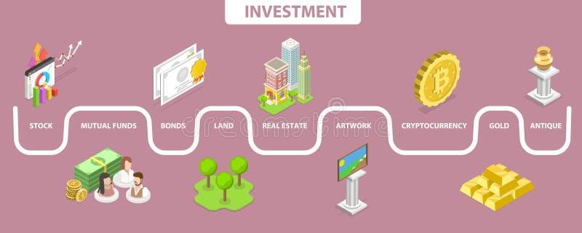
TYPES OF INVESTMENT ASSETS
EQUITY (stocks)
FIXED INCOME (bonds)
MUTUAL FUNDS
ETFs (exchange-traded funds)
CASH AND EQUIVALENTS

Slide 6
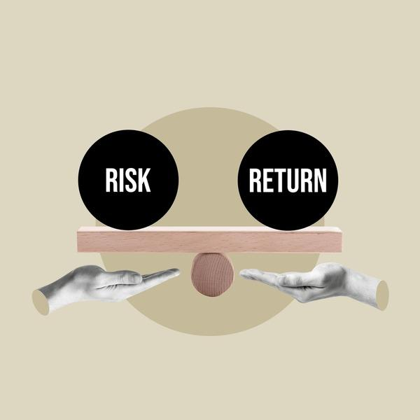
RISK AND RETURN ANALYSIS
Risk is the possibility of loss in an investment.
Return is the gain or profit from an investment.
High risk = High return potential
Diversification helps minimize risk.

Slide 7

PORTFOLIO CONSTRUCTION PROCESS
Set investment objectives
Assess risk tolerance
Asset allocation
Portfolio selection
Performance monitoring and rebalancing

Slide 8

TOOLS USED IN PORTFOLIO MANAGEMENT
EXCEL (for data analysis)
FINANCIAL WEBSITES (e.g., money control, NSE India)
RISK ANALYSIS METRICS (e.g., beta, standard deviation, shape ratio)

Slide 9

KEY LEARNINGS FROM INTERNSHIP
Practical exposure to market analysis
Learned how to select the right mix of assets
Understood risk assessment and portfolio rebalancing
Gained confidence in using financial tools and platforms

Slide 10
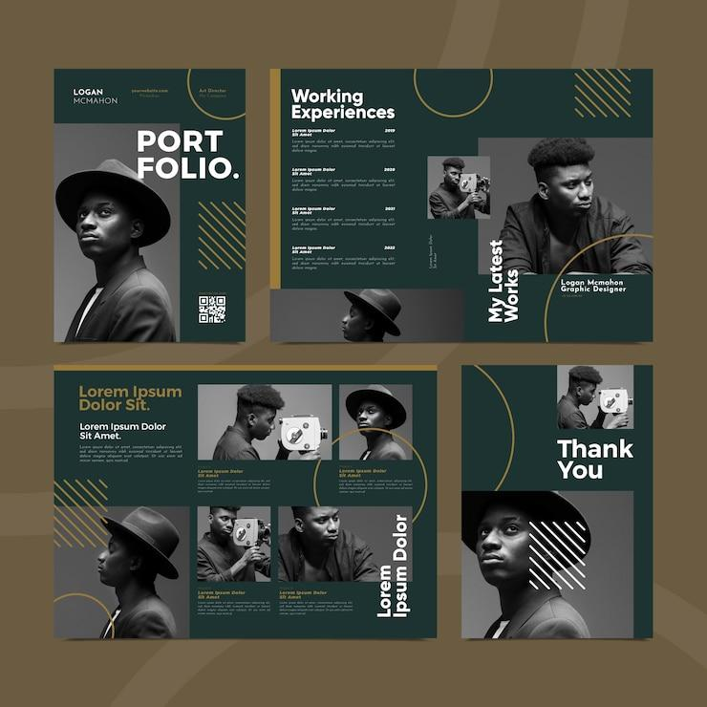


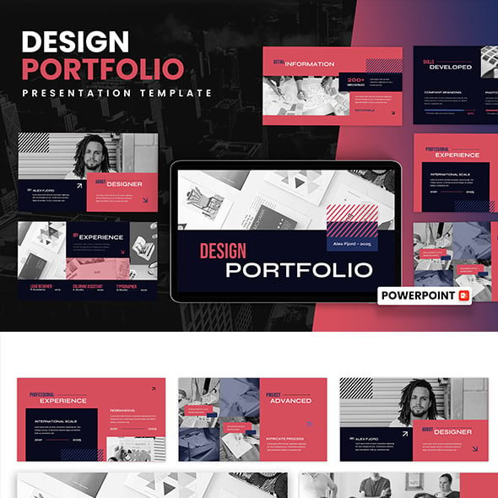


PORTFOLIO TEMPLATES

Slide 11

CONCLUSION
This internship helped bridge the gap between theory and practical applications in portfolio management. The project improved my analytical, decision-making, and investment planning skills.

